Slide 1


Digital systems
Chapter 4
Sequential Circuits
Dr. Iness NEDJI MILAT (Lecturer)
iness.nedji@ensia.edu.dz
Pr. Nasreddine LAGRAA
First year – 2023/2024
Nasredine,lagraa@ensia.edu.dz

Slide 2
Sequential vs. combinational circuit
Combinational circuit output depends only on current inputs
How can we design a circuit that stores information?
  Use a feedback
Sequential circuit is a combinational circuit with feedbacks (storage elements).
  EX : Counters and Shift registers.
Some sequential circuits may not contain combinational circuits, but only storage elements
  Ex : Registers (set of bits).
The output of a sequential circuit depends not only on current inputs but also on the previous outputs (states).
n inputs
m
outputs
Combinational
Logic
•
•
•
•
•
•
Internal input
(present state)
Storage element
Internal output (next state)
Sequential circuit

Slide 3
Storage elements
Internal outputs of a sequential circuit are fed back via storage elements
The storage elements (memory) are circuits that are capable of storing binary information.
The binary information stored in these memory elements at any given time defines the state of the sequential circuit at that time.
Each storage element memorize one bit with two states (0 or 1)

Slide 4
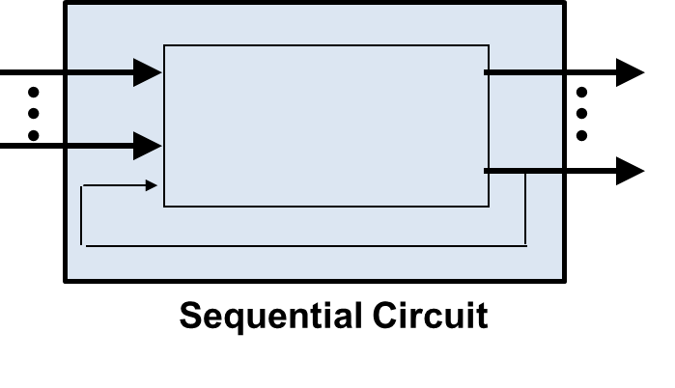

Types of sequential circuits
Sequential circuits can be Asynchronous or Synchronous.
  Asynchronous sequential circuits
    change their states and output values whenever
    a change in input values occurs.
  Synchronous sequential circuits
    change their states and output values at fixed
    points of time, i.e. clock signals. (Clk = 1)
Clk

Slide 5
The clock
In synchronous circuits, state values are controlled by clock signals.
  A “clock” is a special circuit that sends electrical pulses through a circuit.
Clocks produce electrical waveforms such as the one shown below.
clock
high
rising
edge
falling
edge
1
0
clock
period
clock
low

Slide 6
Clock Disciplines
State changes occur in sequential circuits only when the clock ticks.
Level sensitive
  State changes when clock is high (or low)
Edge triggered
  State changes at clock edge
Circuit
CLK
positive edge-triggered
Circuit
CLK
negative edge-triggered
Circuit
CLK

Slide 7
Basic Storage Element

Slide 8
Basic storage elements
Generally, there are two types of storage elements used: Latches, and Flip-Flops.
Latches : A latch is an asynchronous memory element whose excitation signals (inputs) control the state of the circuit.
  A latch has two stages Set and Reset. Set input sets the output to 1. Reset input sets the output to 0.
Flip-flops : A flip-flop is a synchronous memory element that has clock signals control the state of the circuit.
  Flip-flop is a latch with clock input signal

Slide 9
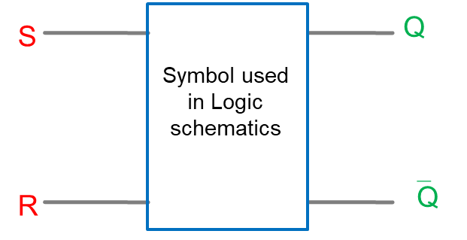
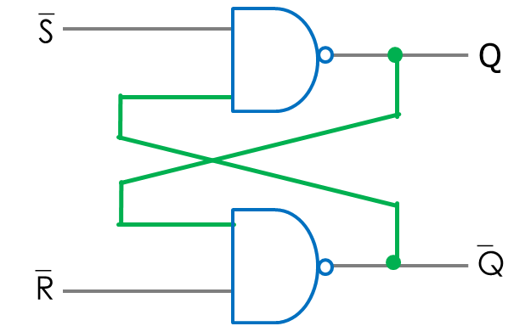
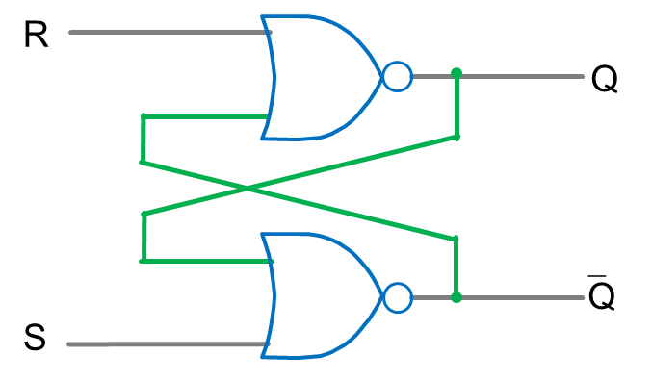
SR Latch
The SR latch is the basic memory element. It has two input signals (S and R) and two outputs (Q and Q’).
Basic Latches can be constructed using two NAND gates or using two NOR gates
SR Latch
  Active
  Low
  Active
  High
Two cross-coupled NAND gates
Two cross-coupled NOR gates

Slide 10

A B Or Nor
SR Latch
0 0 0 1
0 1 1 0
1 0 1 0
1 1 1 0
Active high
Present state
Next state
0
1
R
0
1
Q
S R Q₀ | Q | Q’
Function
0 | 0 | 0
0 | 1
Q = Q₀
Store (hold)
0 | 0 | 1
1 | 0
Q = Q₀
0
0
1
0 | 1 | 0
0 | 1
Q = 0
Put 0 in bit
‾Q
0 | 1 | 1
0 | 1
Reset
0
Q = 0
S
1
1
1 | 0 | 0
1 | 0
0
Q = 1
Put 1 in bit
1 | 0 | 1
1 | 0
Q = 1
Set
1 | 1 | 0
0 | 0
Q = Q’
Forbidden
1 | 1 | 1
0 | 0
Q = Q’
To avoid

Slide 11
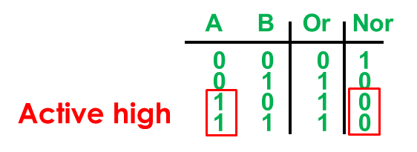
Timing Diagram Representation
R=0
Q
R=0
Q
R=1
Q
R=0
Q
0
1
0
1
1
0
1
0
1
0
1
0
0
1
0
1
Q’
Q’
Q’
Q’
S=1
S=0
S=0
S=0
R
1
0
S
1
0
Q
1
0
Q’
1
0
Time
Gate delay
Wire delay + Gate delay = Latch delay

Slide 12


SR Latch with NOR
S R Q₀ | Q | Q’
R
S
0 | 0 | 0
0 | 1
Q
‾Q
0 | 0 | 1
1 | 0
0 | 1 | 0
0 | 1
0 | 1 | 1
0 | 1
1 | 0 | 0
1 | 0
1 | 0 | 1
1 | 0
1 | 1 | 0
x | x
1 | 1 | 1
x | x
 |  | 00 | 01 | 11 | 10
0 |  | 0 | 0 | X | 1
1 |  | 1 | 0 | X | 1
$$SR$$
$$Q(t)$$
characteristic equation
Q(t+1) = S + R’ Q(t)
Next state
Q+
Present state
Q

Slide 13
SR gated Latch
Similar to the SR latch but with the extra control input EN which enables or disables the operation of the S and R inputs.
  When EN=1, the gated SR latch operates as an SR latch.
  When EN=0, S and R are disabled and the circuit persists in the preceding state.
EN | S | R | Q | Q⁺
0 | x | x | 0 | 0
0 | x | x | 1 | 1
1 | 0 | 0 | 0 | 0
1 | 0 | 0 | 1 | 1
1 | 0 | 1 | x | 0
1 | 1 | 0 | x | 1
1 | 1 | 1 | x | NA
R
Q
Q
EN
S

Slide 14
Takeaway
The fact:
  Set-Reset (SR) Latch can store one bit and we can change the value of the stored bit. But,
The problem:
  SR Latch has a forbidden state.
Question:
  How do we avoid the forbidden state of SR Latch?
Response:
  Ensure that inputs S and R
  are never equal to 1 at the same time,
How ?
D Latch

Slide 15
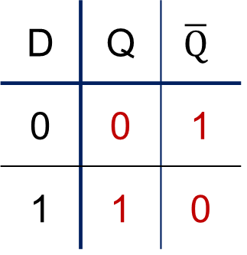
D Latch
D latch ensures that inputs S and R never equal to 1 at the same time.
D Latch can store and change a bit like an SR Latch while avoiding the forbidden state.
0
1
0
R
1
D | Q | $$\overline{Q}$$
0 | 0 | 1
1 | 1 | 0
1
D
0
D
S
Q
Q
R
Q
0
1
S
0
1
Q+ = Q(t+1) = D
Notes:
Start in 0, 0, 1
Change to D = 1
After NOT gate, R = 0
After OR+NOT gates, /Q = 0 (R is already ready then), Q goes to 1
Problem: No way to hold state

Slide 16
D Latch
Data (D) Latch
  Easier to use than an SR latch
  No possibility of entering an undefined state
When D changes, Q changes immediately (…after a delay of 1 NOT gate and 2 NORs gates)
SR latches are useful in control applications
  we often think in terms of setting or resetting a flag to some condition.
D latches are useful to store bits of information
D
S
Q
R
Q

Slide 17
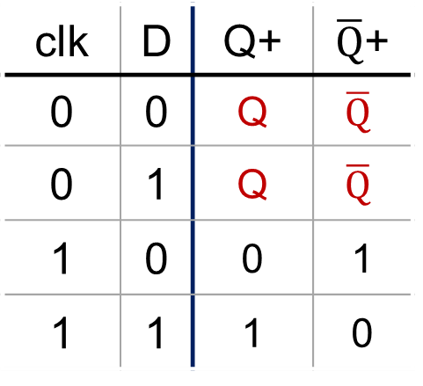

D Flip-Flop (D Latch with Clock)
D
S
Q
D
Q
clk
R
$$\overline{Q}$$
CLK
TruthTable
Excitation Table
clk | D | Q+ | $\overline{Q}$+
0 | 0 | Q | $$\overline{Q}$$
0 | 1 | Q | $$\overline{Q}$$
1 | 0 | 0 | 1
1 | 1 | 1 | 0
CLK | D
↑ | 0 | 0 | 1
↑ | 1 | 1 | 0
↑ : Rising Edge of Clock
Store bit
Reset bit
Set bit
Notes:
Schematic symbol and excitation table for the D flip-flop.

Slide 18
D Flip-Flop: Example Timing Diagram
clock
period
1
CLK
0
1
D
0
1
Q
0
Clock to Q time (TC2Q) =
Latch delay
Set
Reset
Reset
Set
Set
Reset
Reset
Notes:
Timing diagram example for a D flip-flop.

Slide 19
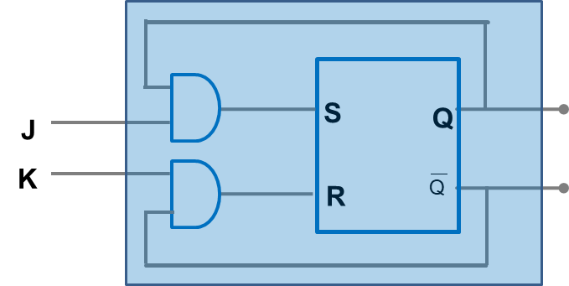
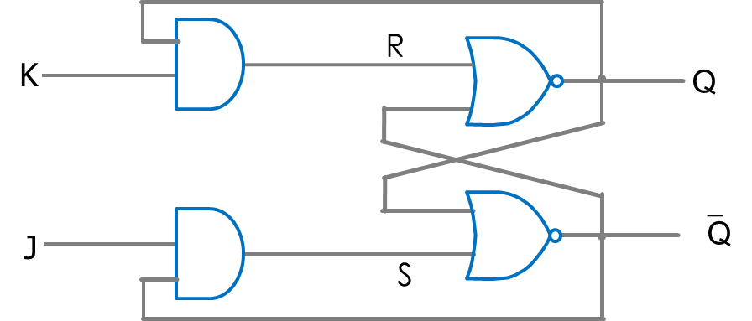
J K Latch
The SR latch can be modified to provide a stable state when both inputs are 1 : use JK latch.
The “JK” is called in honor of his inventor Jack Kilby.
In the JK latch, the inputs J and K behave exactly like inputs S and R, But it provides a stable state when both inputs are 1 (The output is complemented).
J
Q
K
J | K | Q+
0 | 0 | Q_{prev} | No change (hold /store)
0 | 1 | 0 | Reset (clear)
1 | 0 | 1 | Set
1 | 1 | ‾Q | Toggle
Q(t + 1) = JQ`(t) + K`Q(t)

Slide 20
J K Flip flop
JK Latch with clock
J
Q
CLK
K
R
clk | J | K | Q+
0 | x | x | Q | Store
1 | 0 | 0 | Q | Store
1 | 0 | 1 | 0 | Reset
1 | 1 | 0 | 1 | Set
1 | 1 | 1 | ‾Q | Toggle
K
Q
‾Q
CLK
J
S

Slide 21
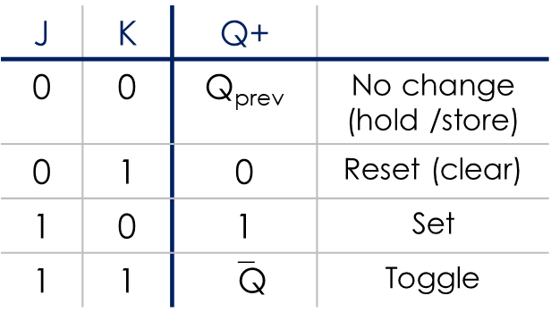
J/K Flip-Flop : Example Timing
1
CLK
0
1
K
0
NO
CHANGE
1
J
0
1
Q
0
NO
CHANGE
SET
TOGGLE
TOGGLE
CLEAR
SET
Notes:
Timing diagram example for a J/K flip-flop.

Slide 22
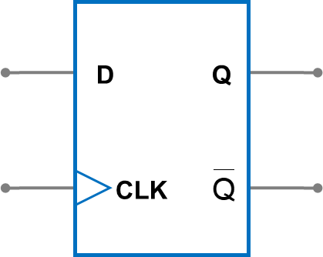
T flip-flop
T (Toggle) Flip-Flop is a complementing synchronous flip-flop.
It can be designed using :
  SR (Set-Reset) Flip-Flop
  D (Data) Flip-Flop
  JK Flip-Flop
T
T | Q(t+1)
0 | Q(t) | No change
1 |  | Complement
Q(t + 1) = T Q = TQ` + T`Q

Slide 23
Implementations of T flip flop
T flip-flop can be implemented using SR flip-flop
T flip-flop can be constructed with a D flip-flop and a XOR gate.
R
Q
Q’
T
CLK
S
T
D
Q
CLK

Slide 24
Implementations of T flip flop
The T flip-flop can also be obtained from a JK flip-flop when inputs J and K are tied together.
T
J
Q
CLK
K

Slide 25
Characteristic Equations
SR flip-flop Characteristic Equations
Q(t + 1) = S+ R`Q(t)
D flip-flop Characteristic Equations
Q(t + 1) = D
JK flip-flop Characteristic Equations
Q(t + 1) = JQ`(t) + K`Q(t)
T flip-flop Characteristic Equations
Q(t + 1) = T Q = TQ`(t) + T`Q(t)

Slide 26
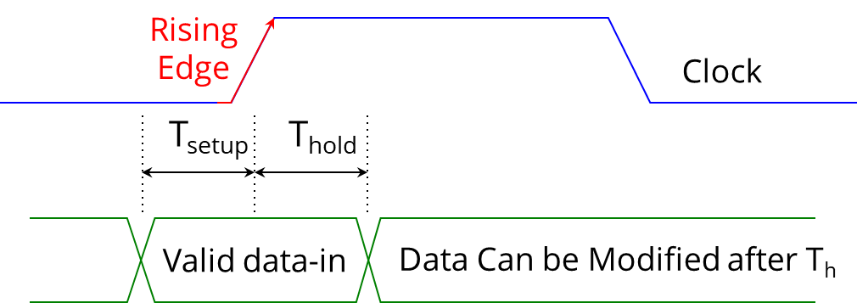
Sequential circuit timing constraints
The Flip-Flop operates properly if the imput signal (Ex: D) is stable (that is, not changing) at the time Clk goes from 0 to 1 (if rising edge). But it may lead to unpredictable results if the input signal also changes at this time.
Constraint 1 : the input signal must be stable between setup time and hold time.
  Setup Time (T_{setup}): Time duration for which the data input must be valid and stable before the arrival of the clock edge.
  Hold Time (T_{hold}): Time duration for which the data input must not be changed after the clock transition occurs.

Slide 27
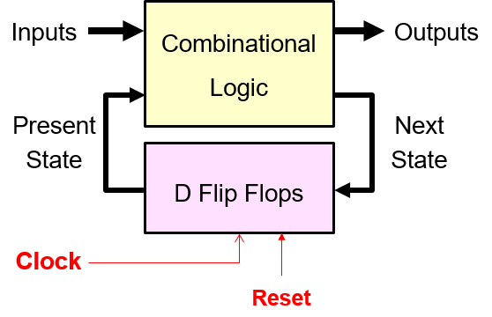
Sequential circuit timing constraints
Constraint 2 : The following timing constraint is required for correct operation of the sequential circuit :
T_{clk} ≥ T_{clk2q} + T_{Combinational} + T_{setup}

Slide 28
Setup time violation
Timing constraint :
T_{clk} ≥ T_{clk2q} + T_{Combinational} + T_{setup}
FF A
FF B
Comb
Logic
D
Q
D
Q
CLK
Q
CLK
Q
CLK
ClktoQ time
Comb Logic time
Setup time
Time Clock
CLK
Setup time
Hold time
D
Setup time Violation : Data stable for a period < setup time
Setup time

